Slide 1
Using Predictive Analytics to Design Investment Strategies for Fintech Lending
Constantin Romanescu
(500762092)
https://github.com/cromanes/Ryerson-Capstone

Slide 2


founded in 2007, in San Francisco;
the largest Peer-to-Peer (P2P) lending institution;
first P2P IPO in December 2014;
more than 41 billion USD in loan issuance (09/2018);
makes its loan data publicly available.

Slide 3

Data analytics pipeline
Cross-Industry Standard Process for Data Mining (CRISP – DM)*
(Chapman et al. (2000). CRISP-DM 1.0. Step-by-step data mining guide. Chicago, Il.)
Tools:
R, SQL;
Cloud computing (Azure ML, h2o.ai)

Slide 4
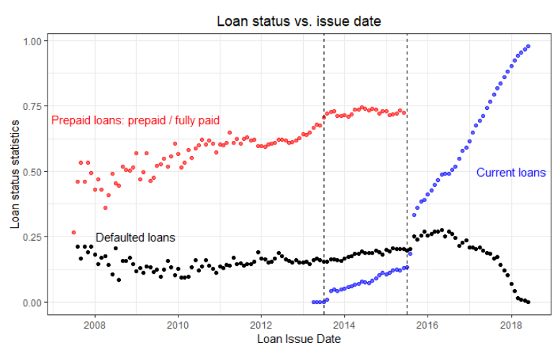
Gaining Insights from Data
→ 3-year loans
→ 5-year loans
Loan defaults and prepayment lead to a decrease in investor earnings.
There is a slight increase in the prepayment rate.

Slide 5
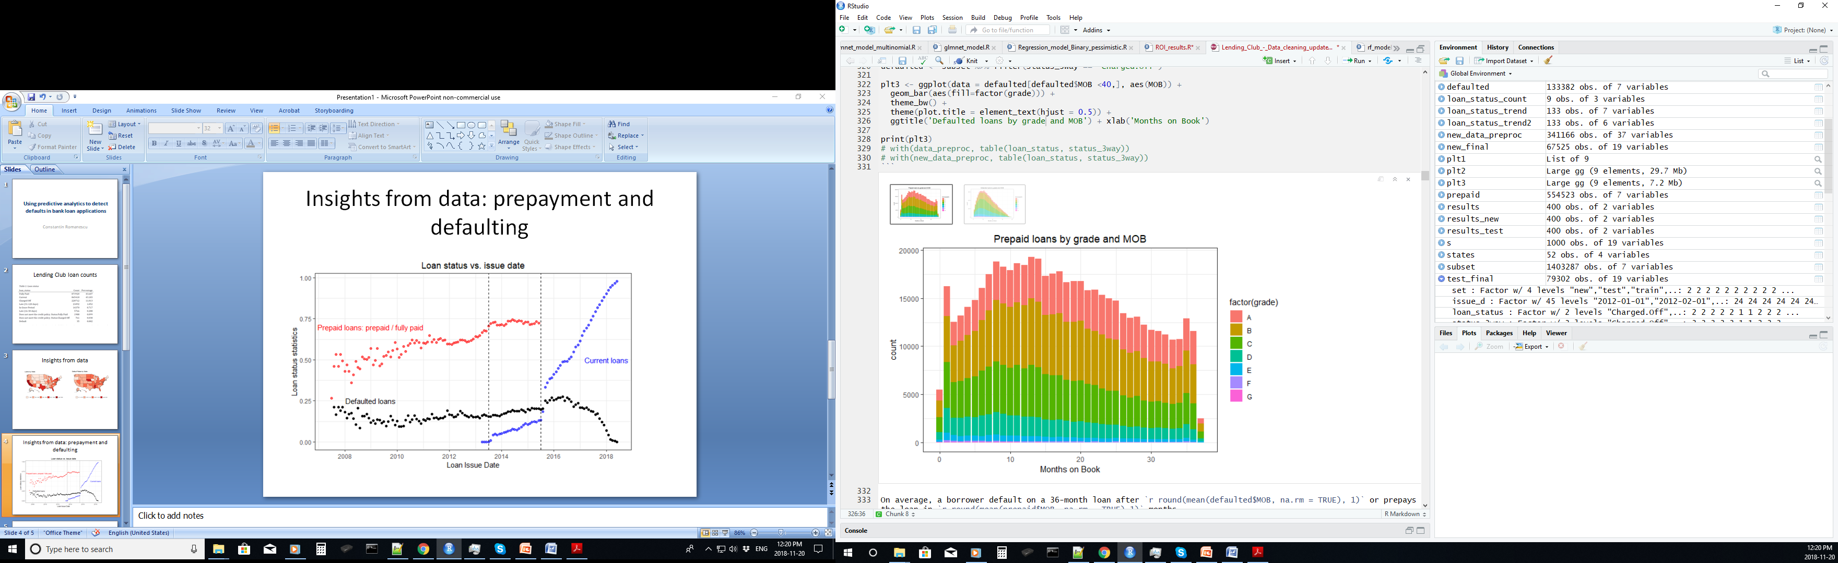
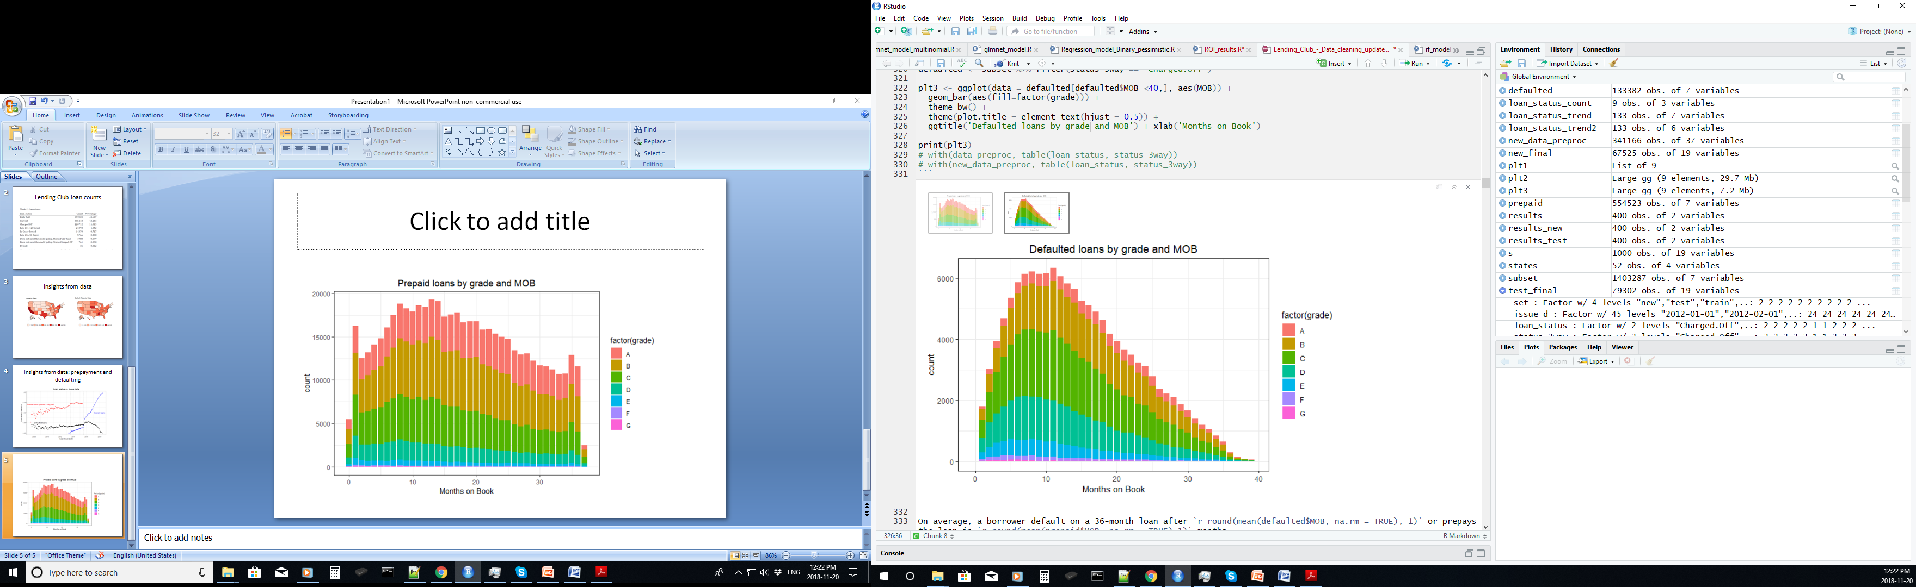
Gaining Insights from Data
Both loan prepayments and loan defaults peak at approximately 12 months;
Borrowers of high grade loans (low interest rate) are more likely to prepay;
Borrowers of lower grade loans are more likely to default on their loans.

Slide 6
Data (pre-)preparation
Feature Selection: remove features added at a later time
Feature Selection: remove features with more than 80% NA’s, (N)ZV, too many levels
Add features with socio-economic impact: unemployment rate,
S&P 500 index, Credit card avg rates, T-bills rates
Basic Feature Transformations
Split data into train – validation – test sets (60/ 20/ 20)
Add a second test set with data released in Nov., 2018

Slide 7
Data preparation
Impute missing values
Feature Selection based on correlation between independent features (Pearson, χ² tests)
Feature Selection based on correlation between loan_status and the independent features (Wilcox, χ² tests)
Data transformation of the numerical variables using basic transformations (log, sqrt, 1/sqrt) to reduce skew
Data transformation of categorical features to reduce the imbalance between levels
Feature Engineering
Apply all transformations to the validation, test and new datasets

Slide 8
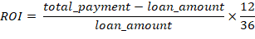
Modelling Approach
Data
Return on Investment
Regression
2-way Regression
Binomial Classification
3-way Regression
Multinomial Classification

Slide 9
Binomial Classification - Approach
Choose an algorithm
Run feature selection
Tune algorithm parameters using the train and validation sets
Measure performance metrics of the test and new datasets
Measure the variance of performance metrics using repeated cross-validation (10 x 10)

Slide 10
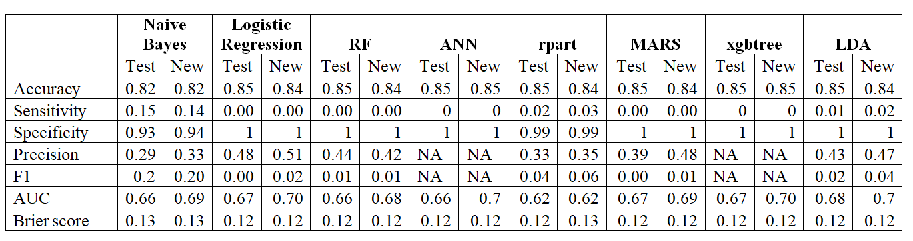
Binomial Classification - Results
Default is the positive class (except for the AUC calculations);
Most algorithms fail to identify a single default case;
AUC and Brier coefficient calculations indicate a rather good separation between default and non-default cases;
Needs to look more closely at the ROC.

Slide 11
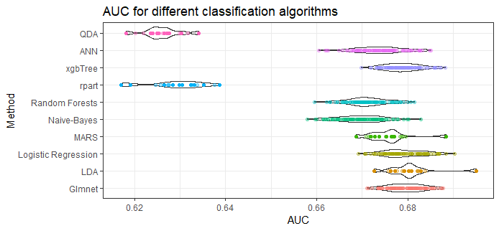

Binomial Classification - Results
One-way Anova
TuckeyHSD
Occam’s razor
Logistic Regression

Slide 12
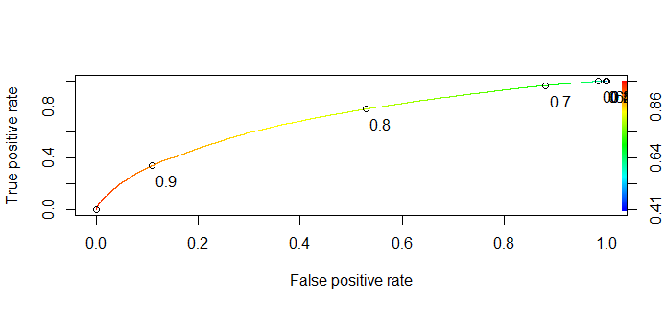
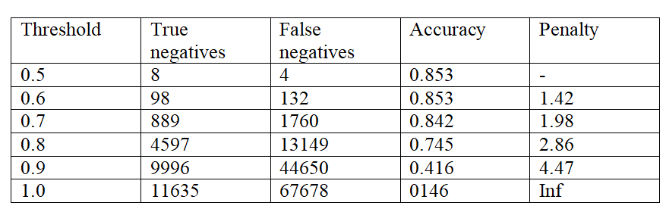
Dealing with unbalanced data

Slide 13

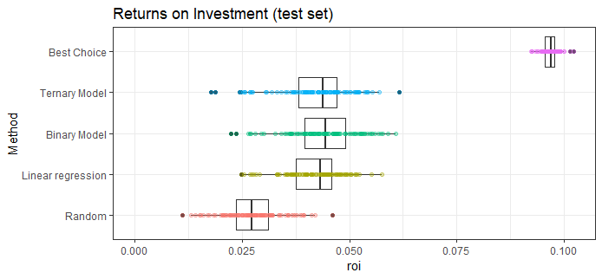
Naïve Model Evaluation
All three models outperform the random model by ~ 60 %;
There are no statistically significant differences between the proposed models;
There is plenty of room for model improvement.

Slide 14
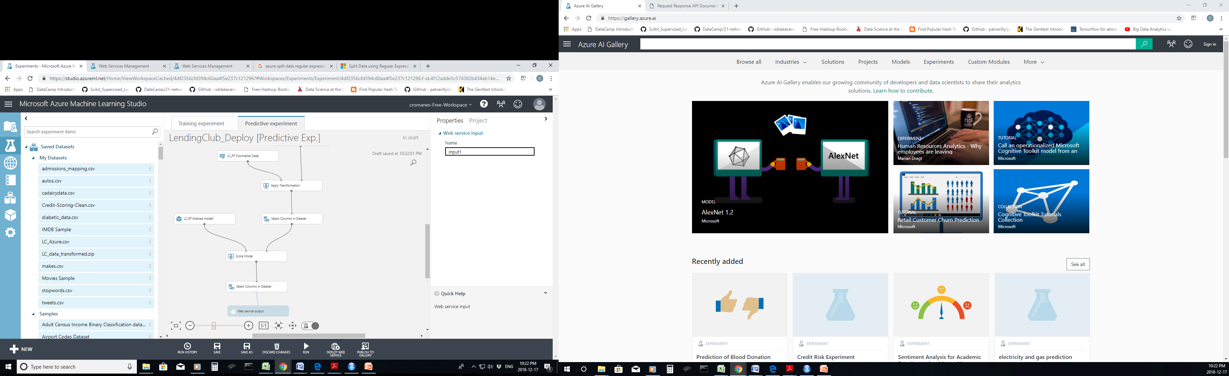
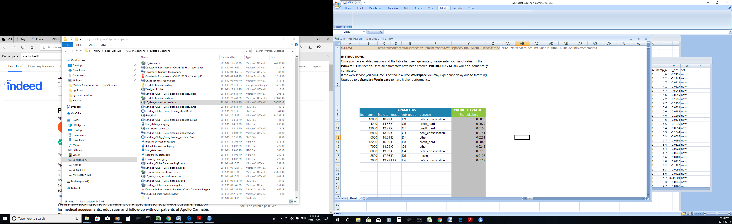
Model Deployment

Slide 15
Conclusions
used statistical and graphical methods to gain insights on the loans offered by Lending Club;
used a wide range of machine learning algorithms to identify loans likely to default;
designed and tested investment models that yield better annualized returns on investment;
classification results are consistent with results from peer-reviewed publications;
created a deployable model using Azure ML.

Slide 16
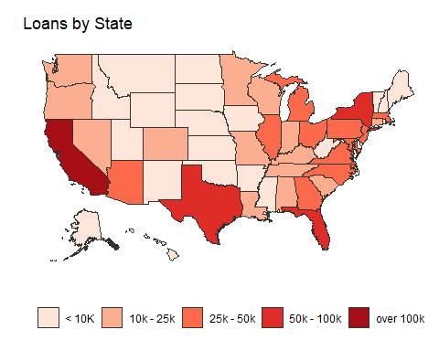
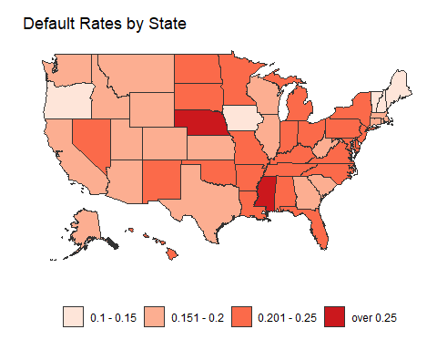
Gaining Insights from Data

Slide 17
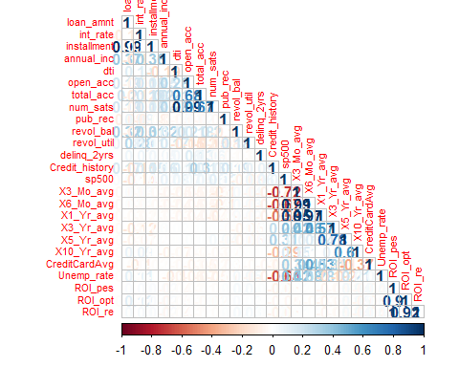
Numeric Values Correlations

Slide 18
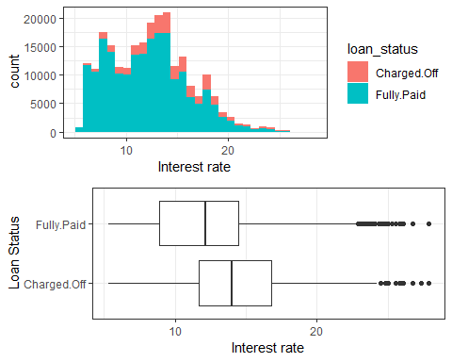
Interest Rate Conditional Plots

Slide 19
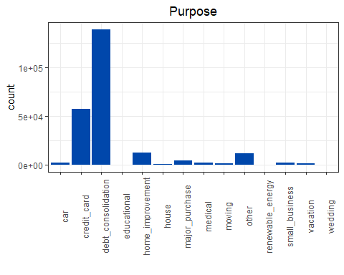
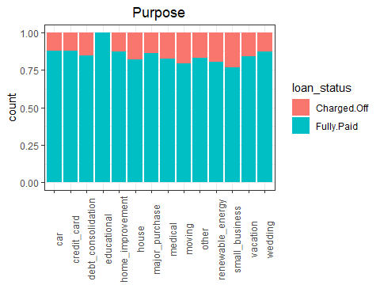
Loan Purpose Conditional Plots

Slide 20
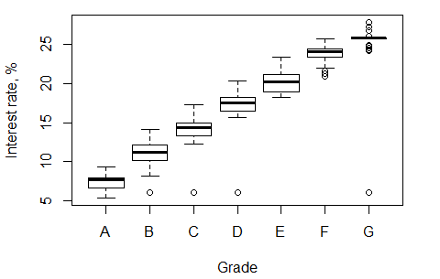
Interest Rate vs. Loan Grade

Slide 21


